Slide 1





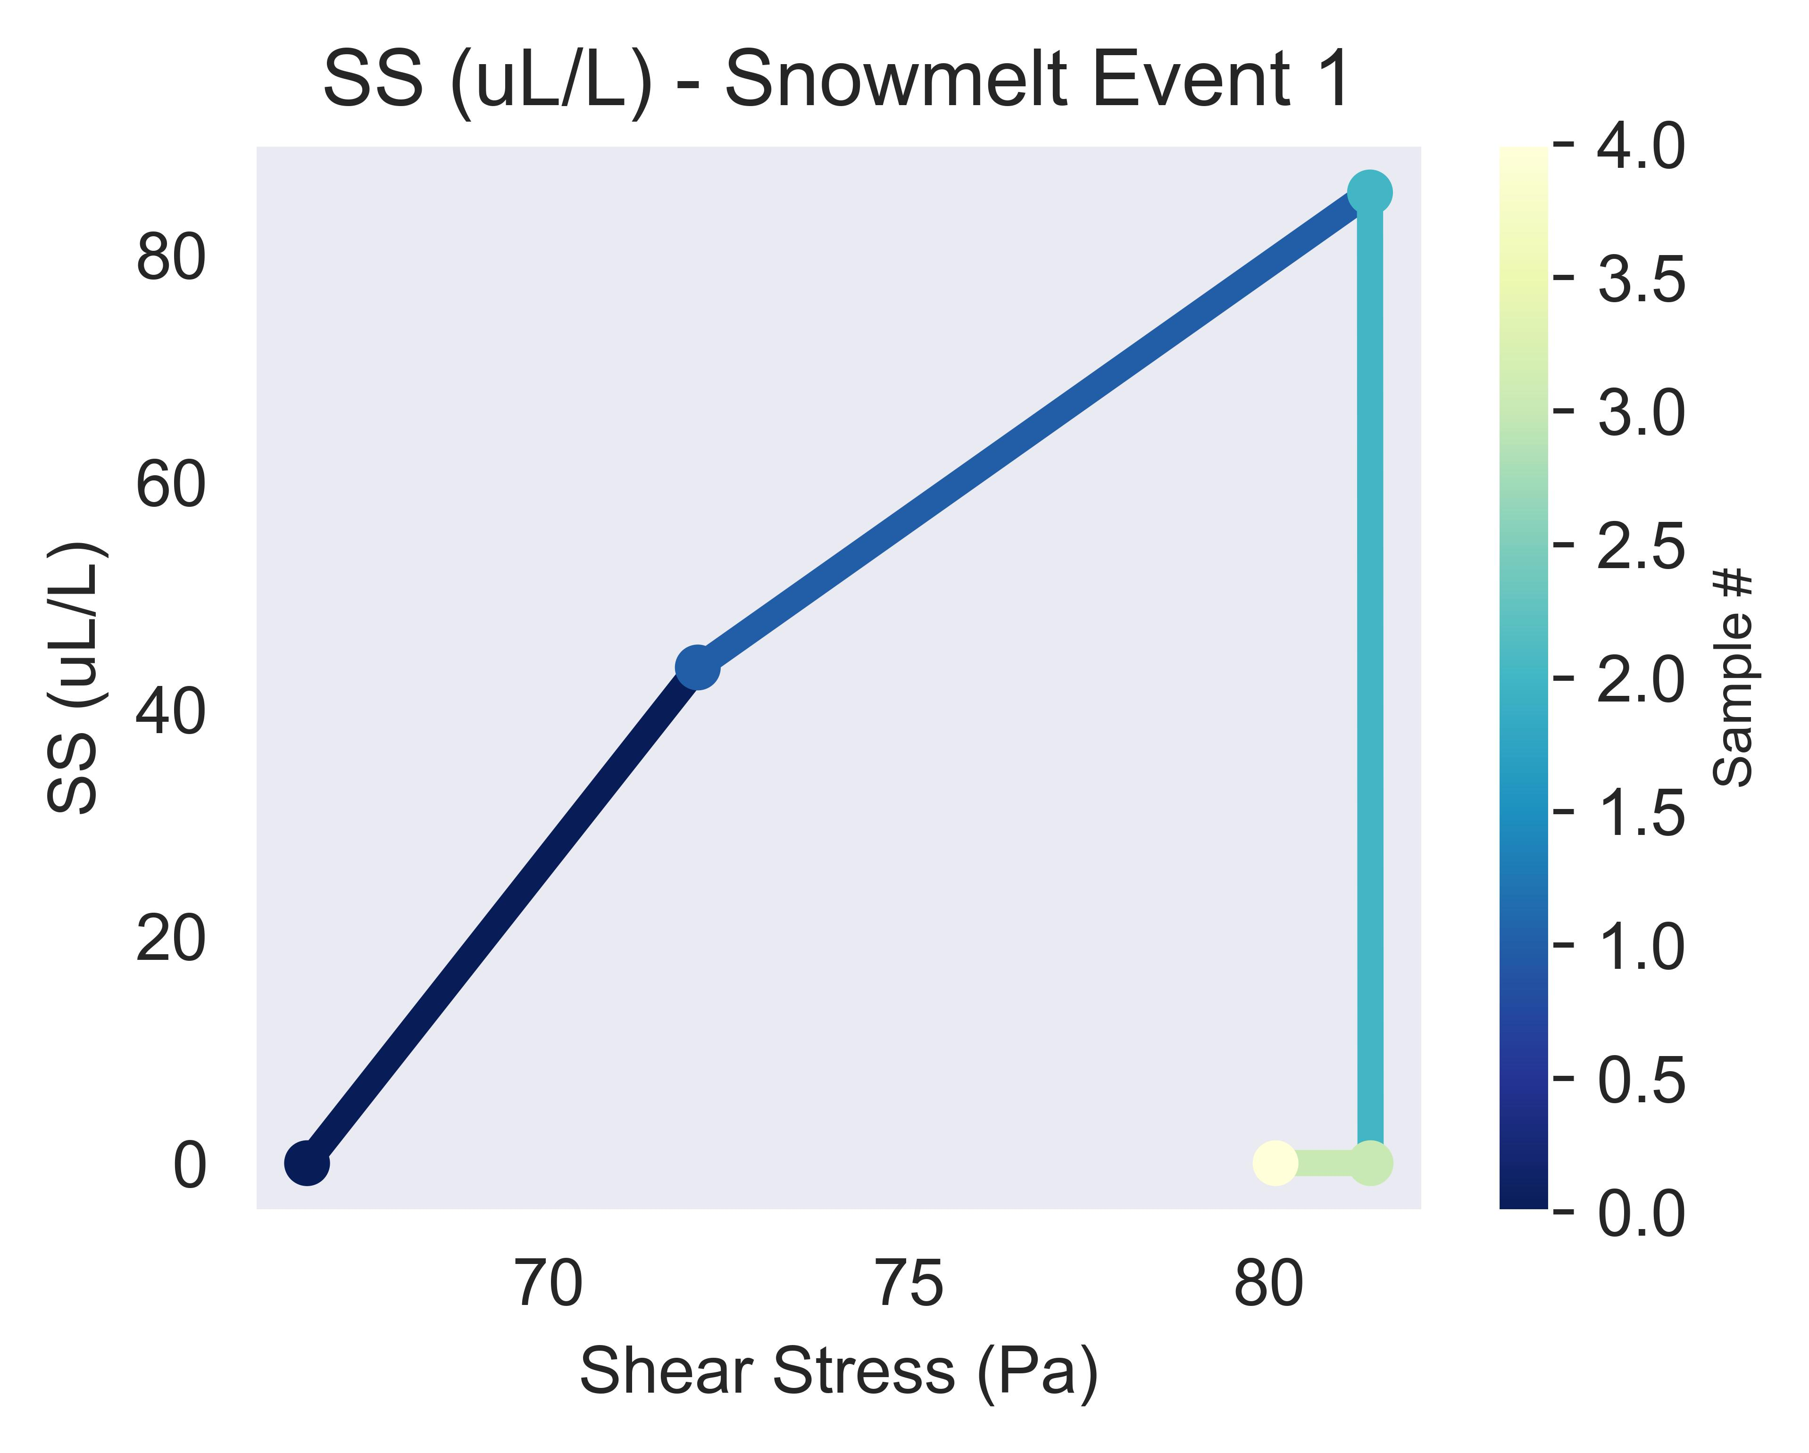
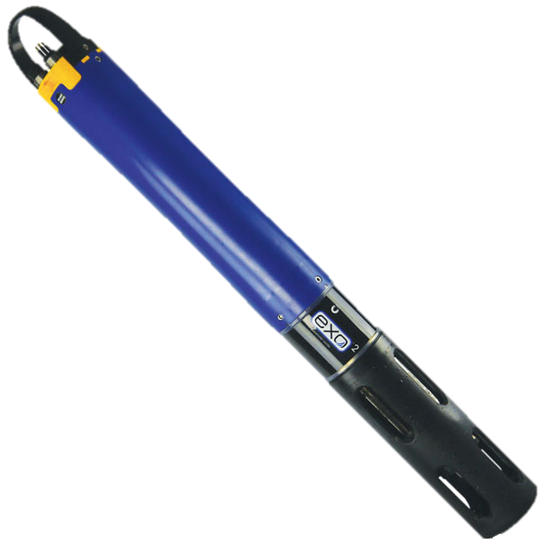
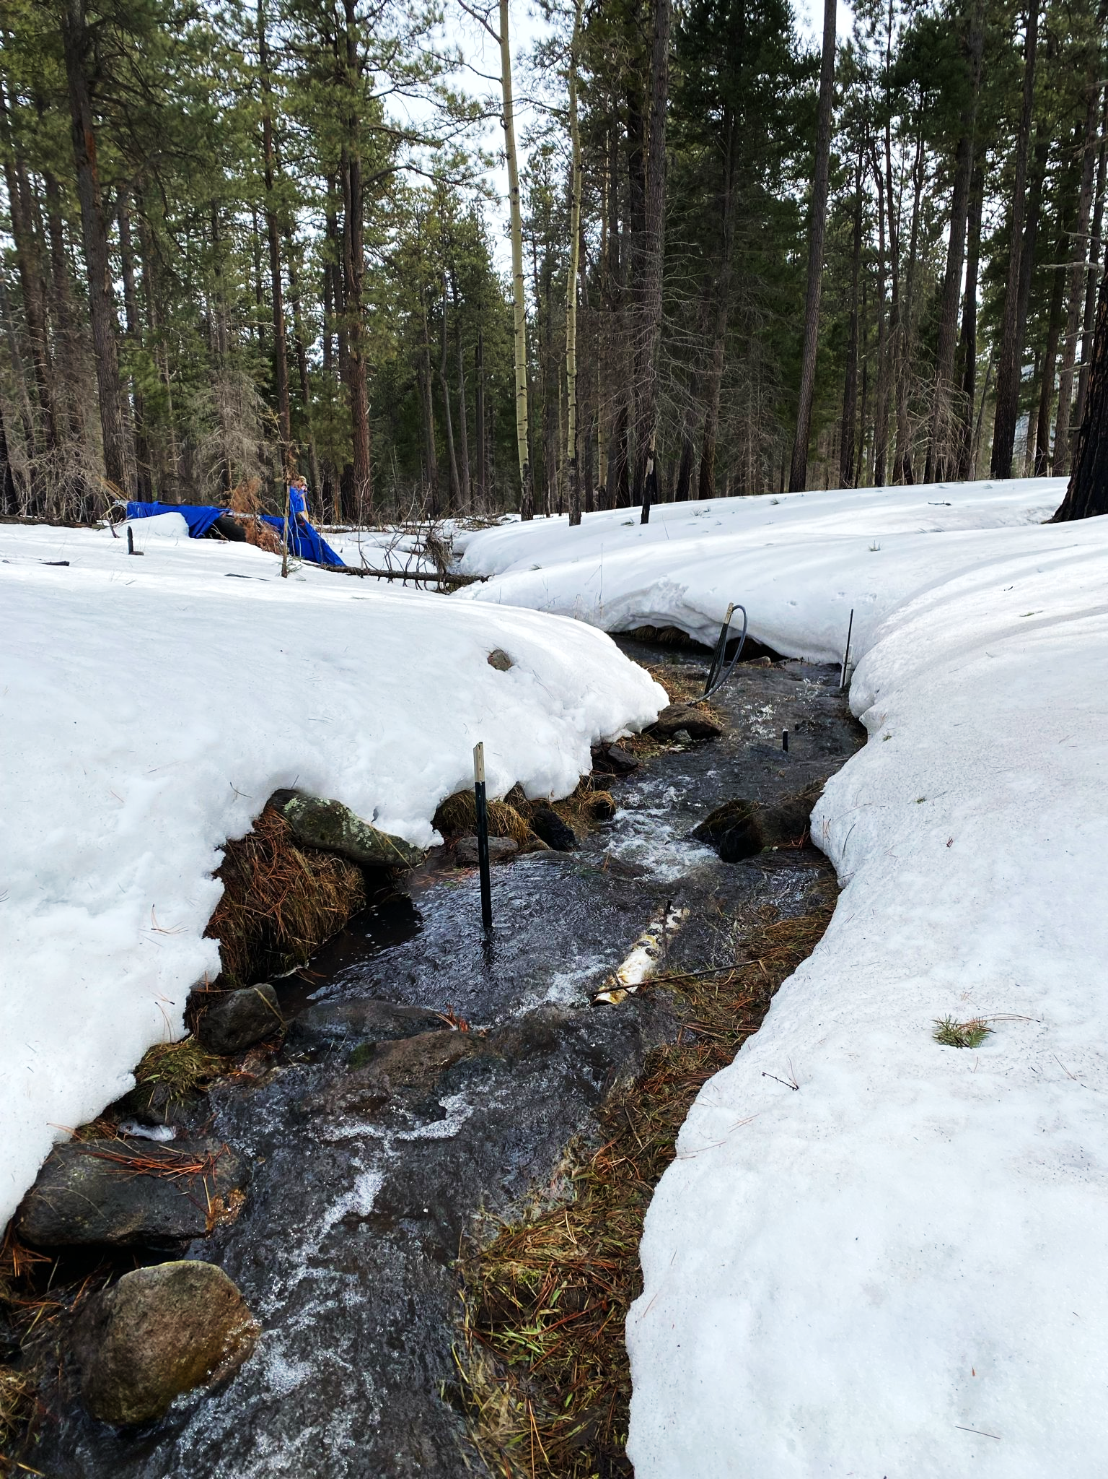
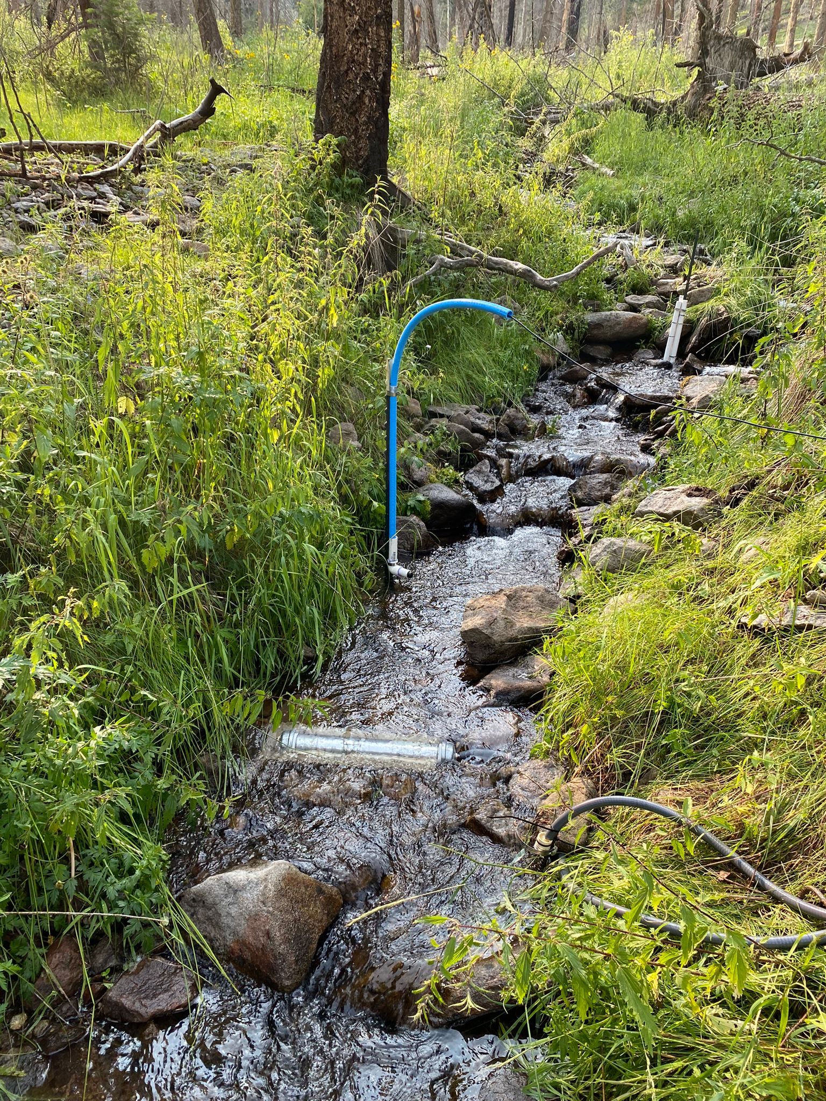
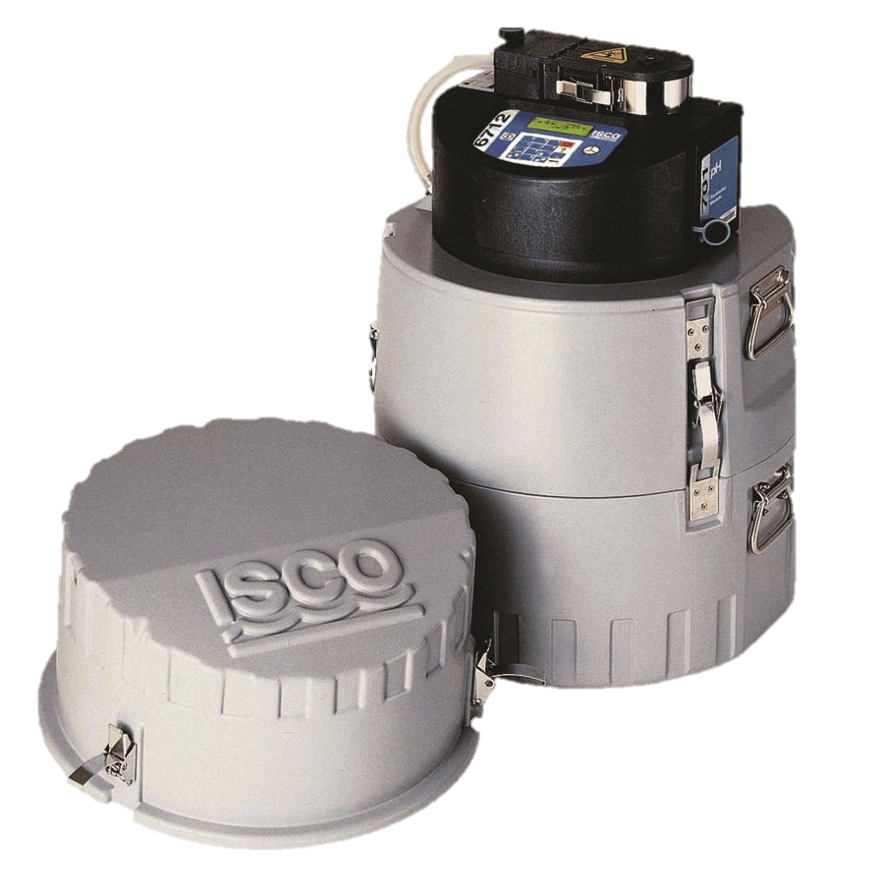
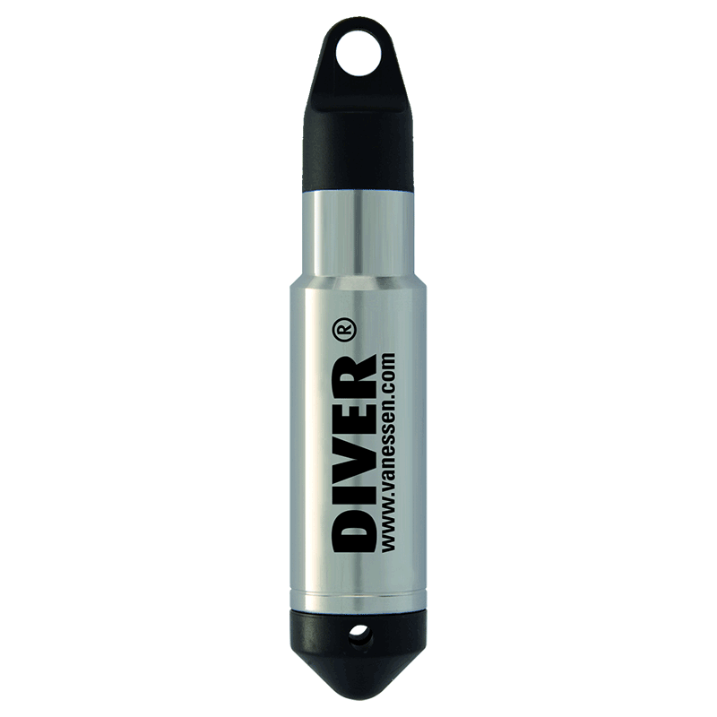
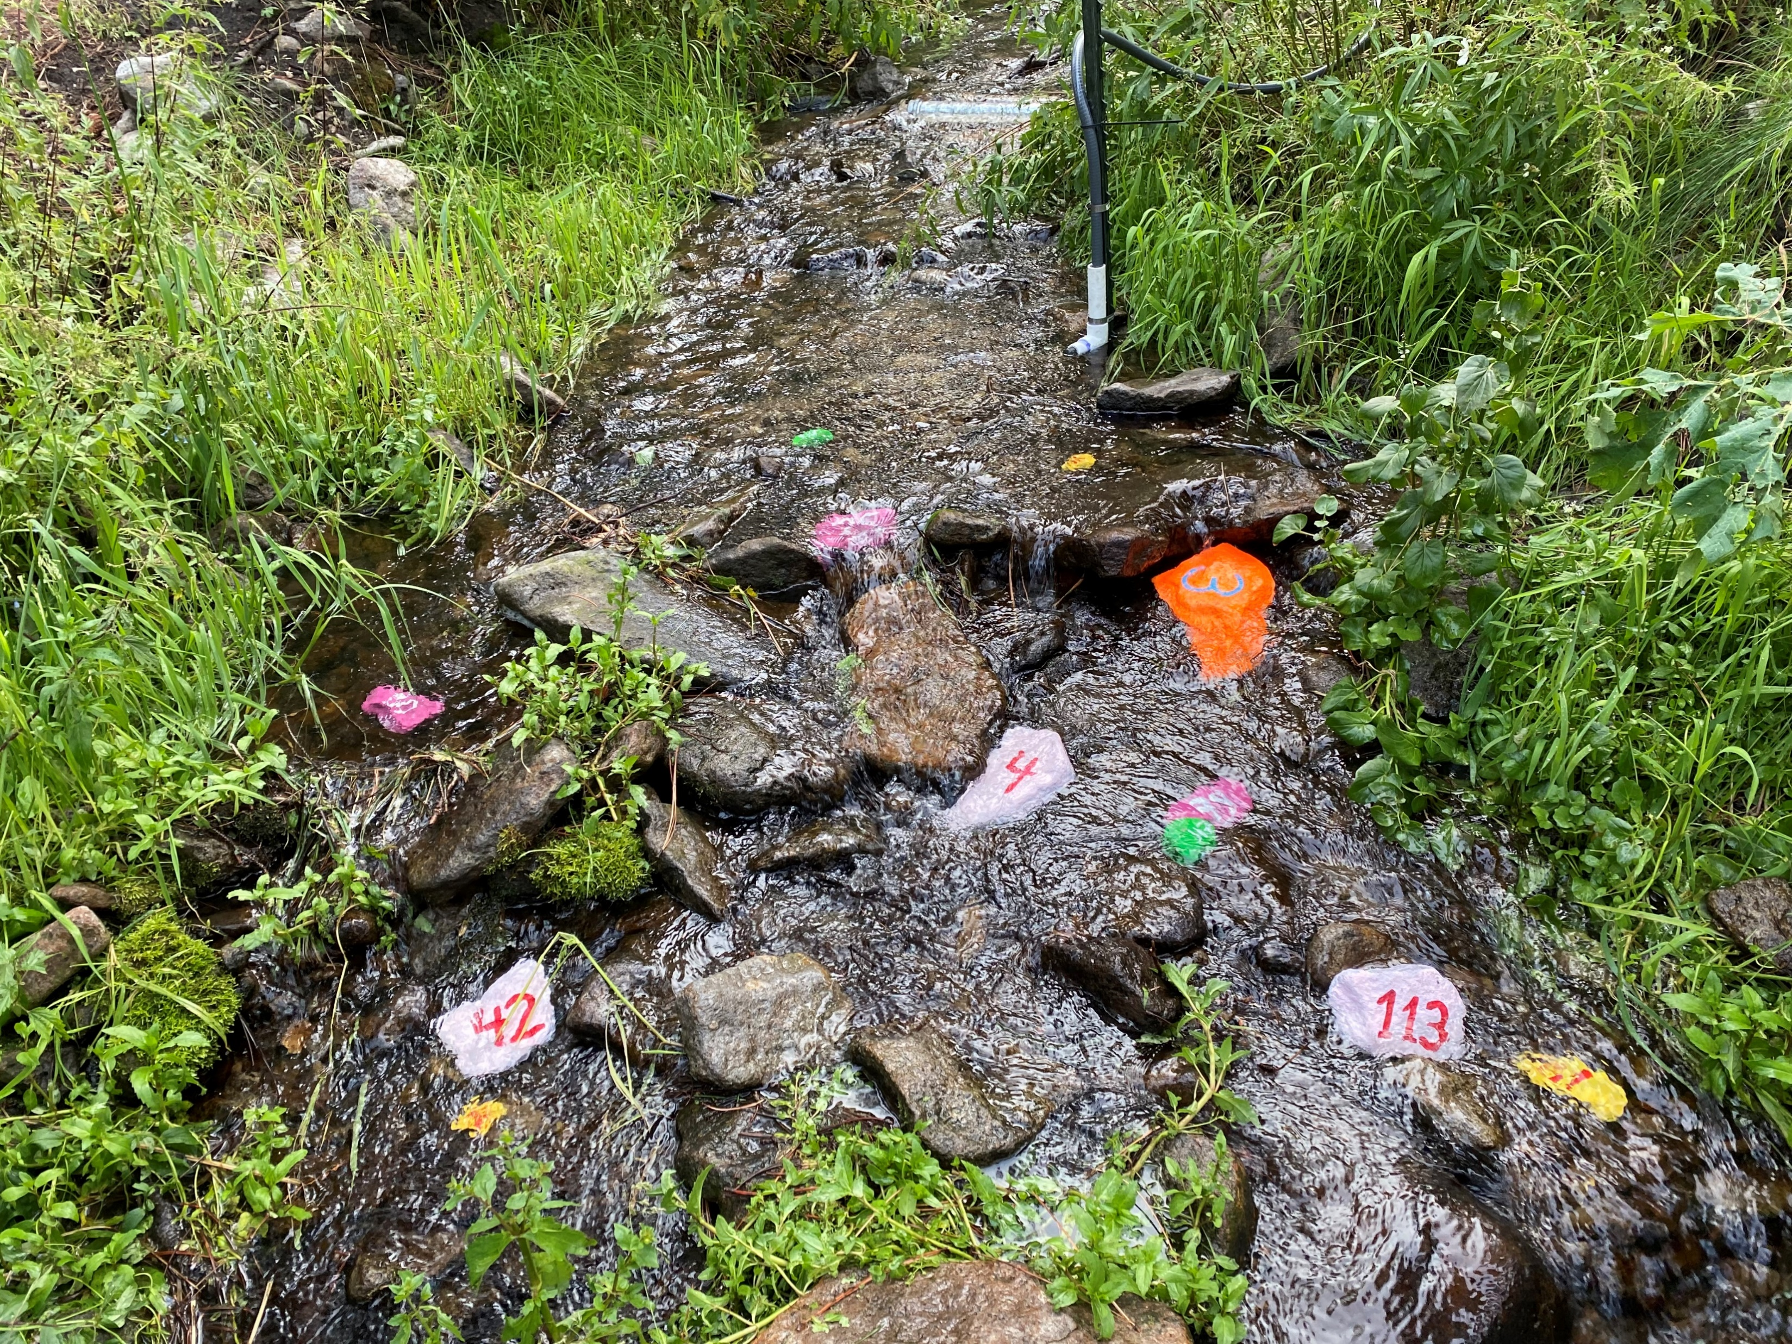
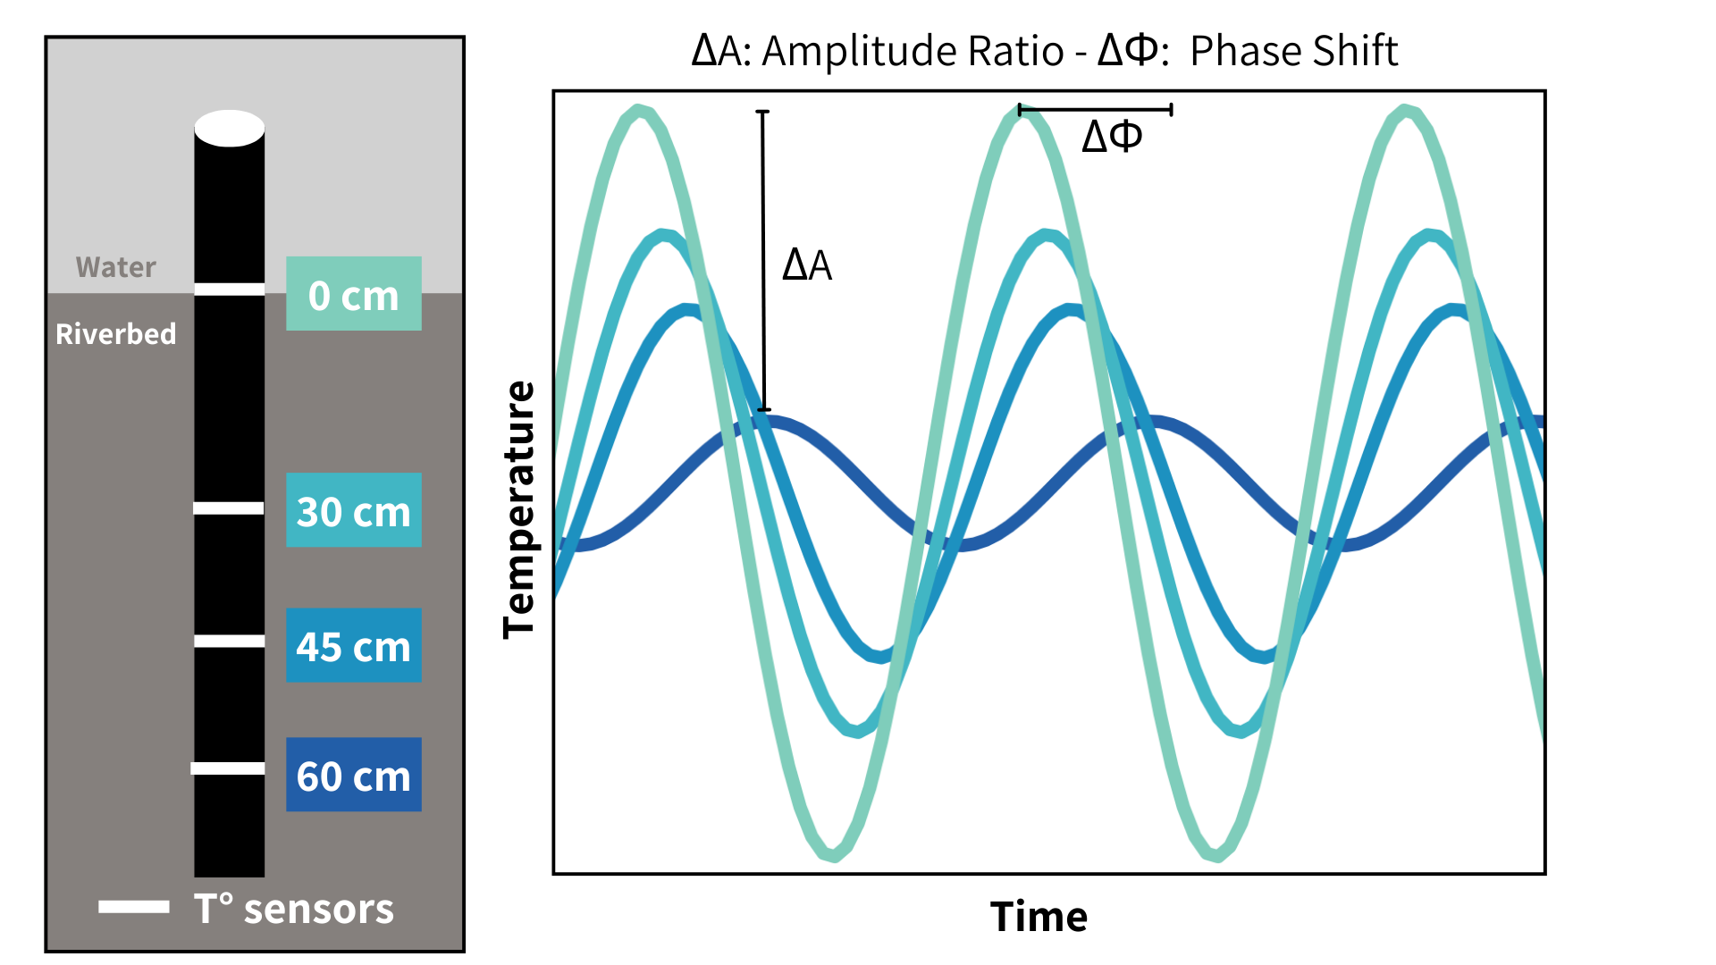
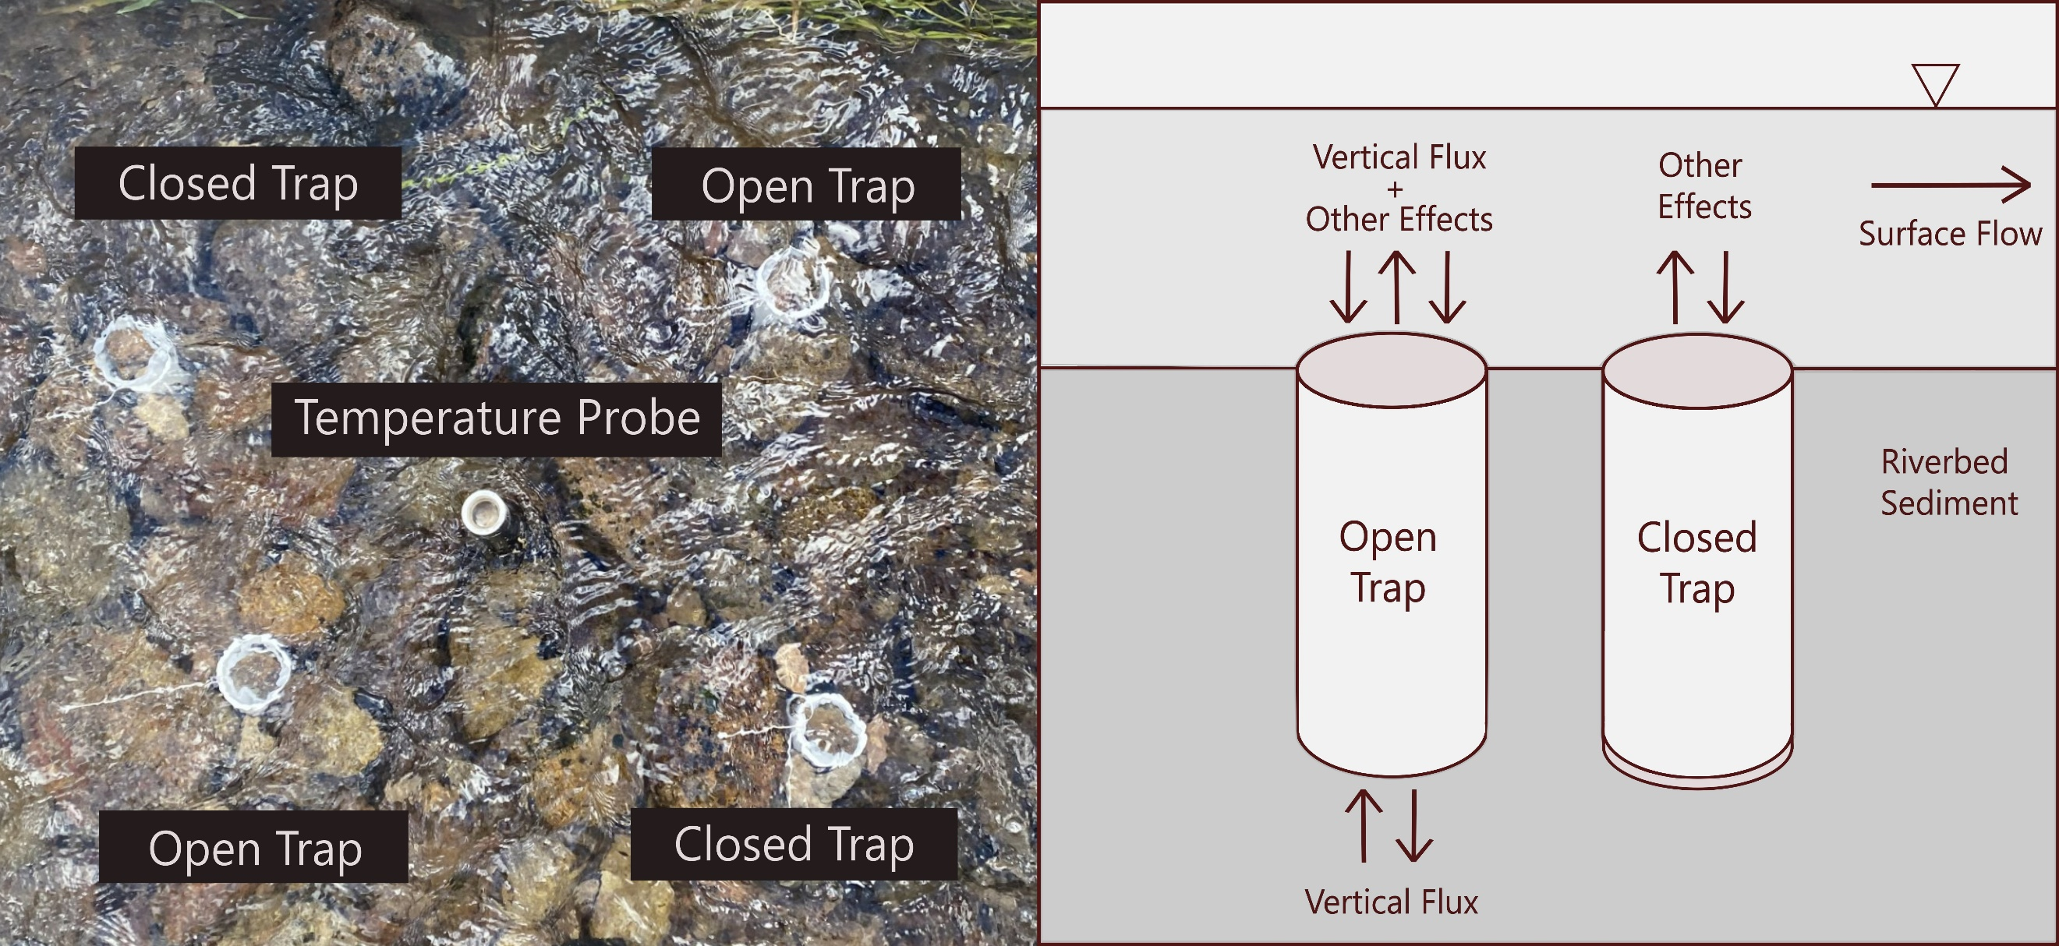
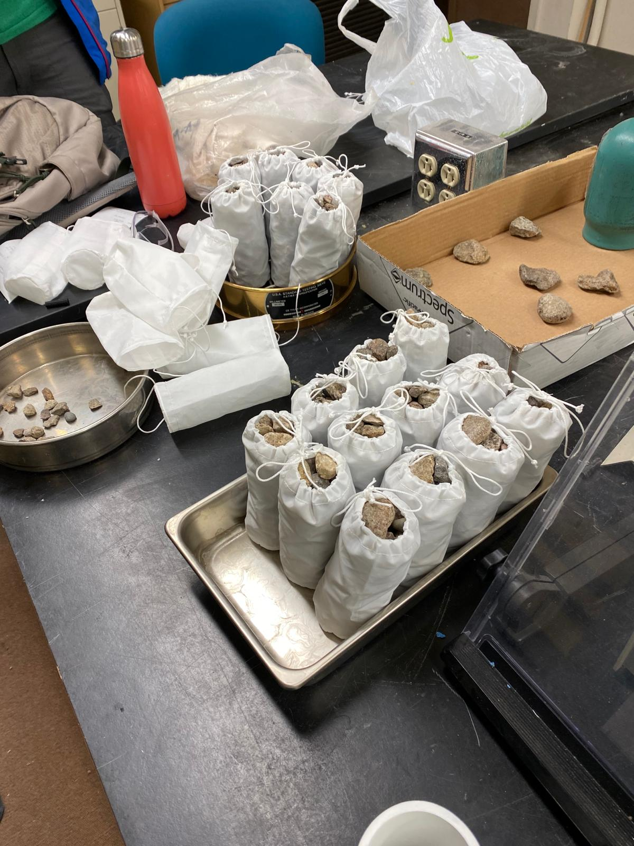
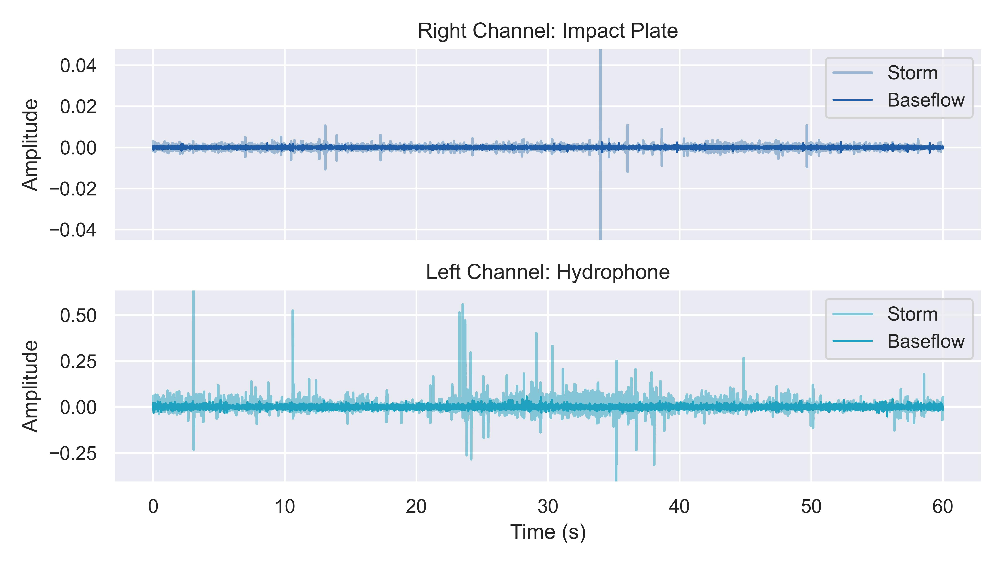
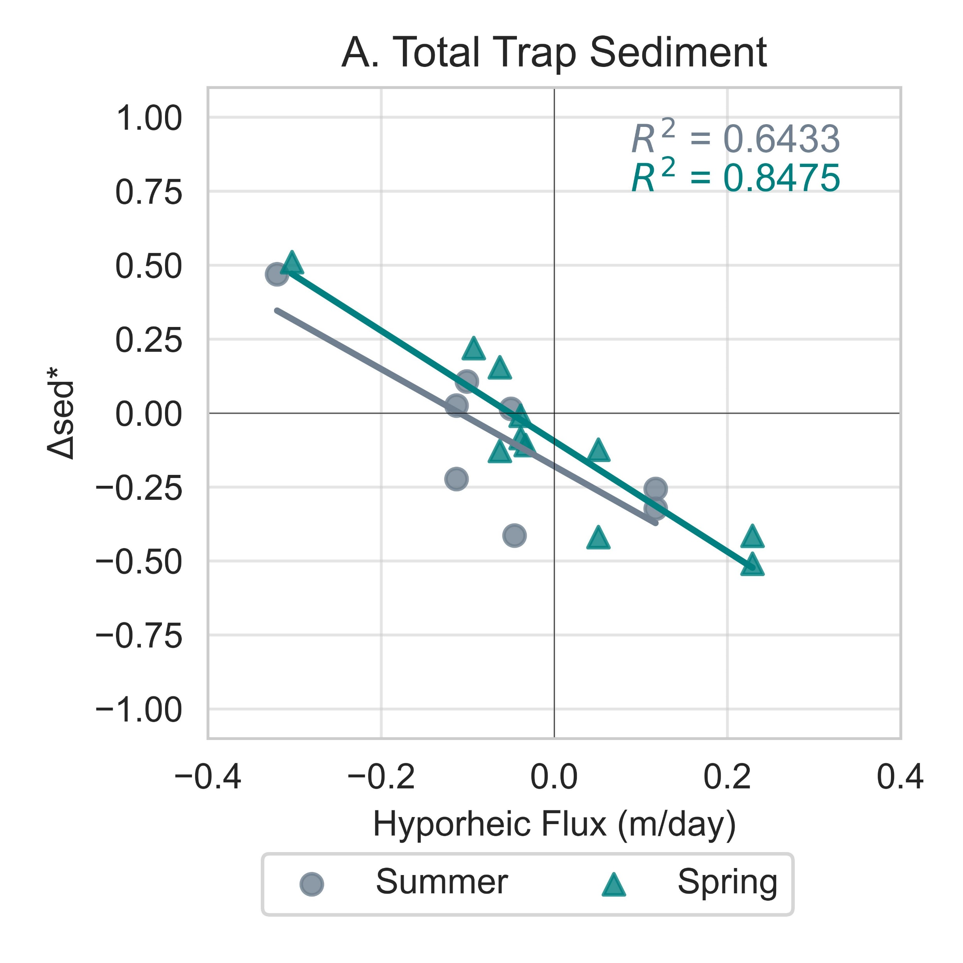
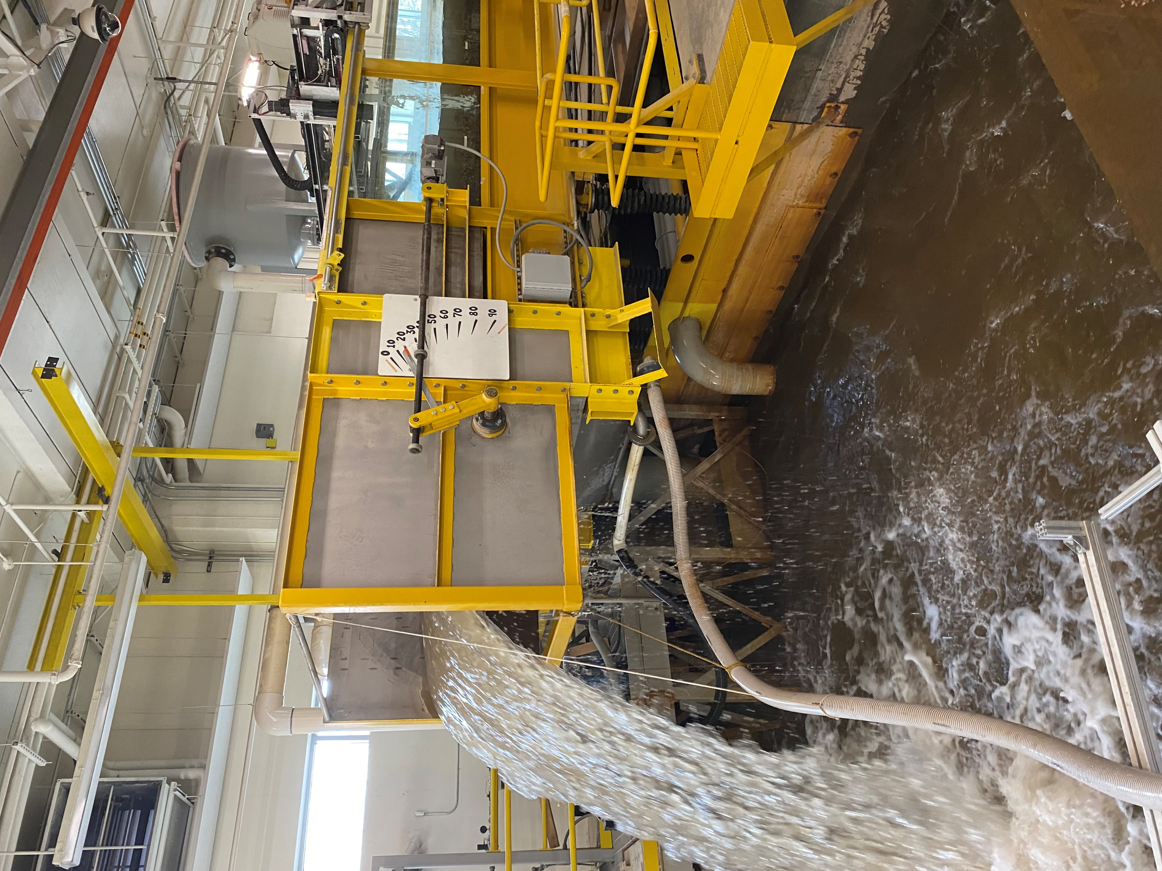
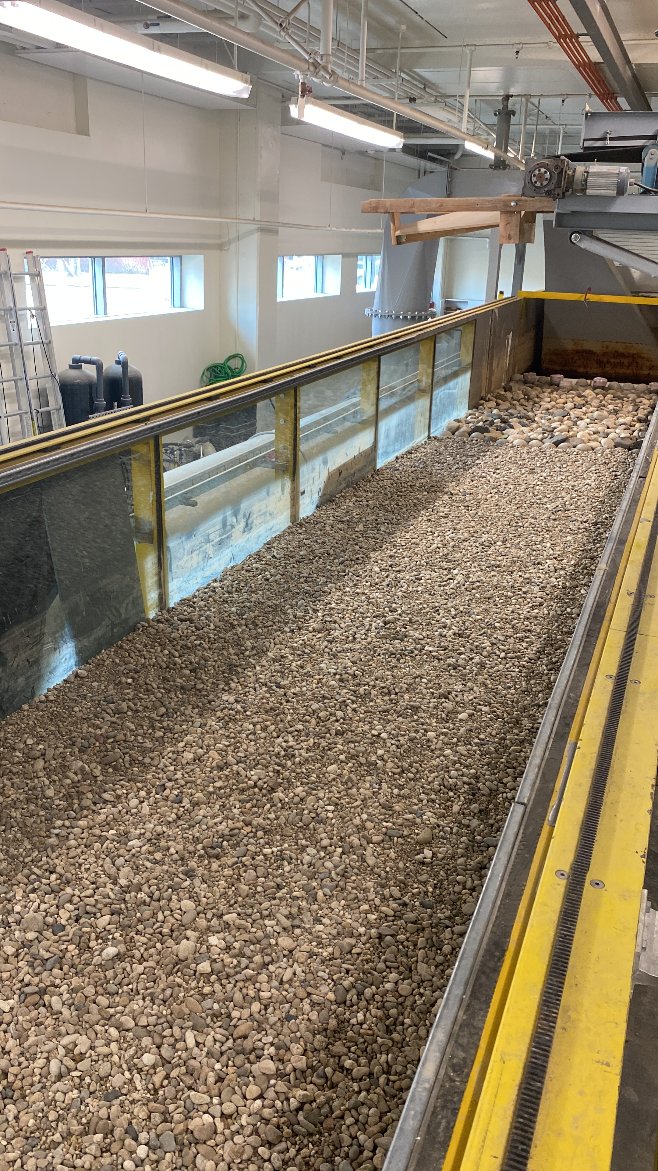
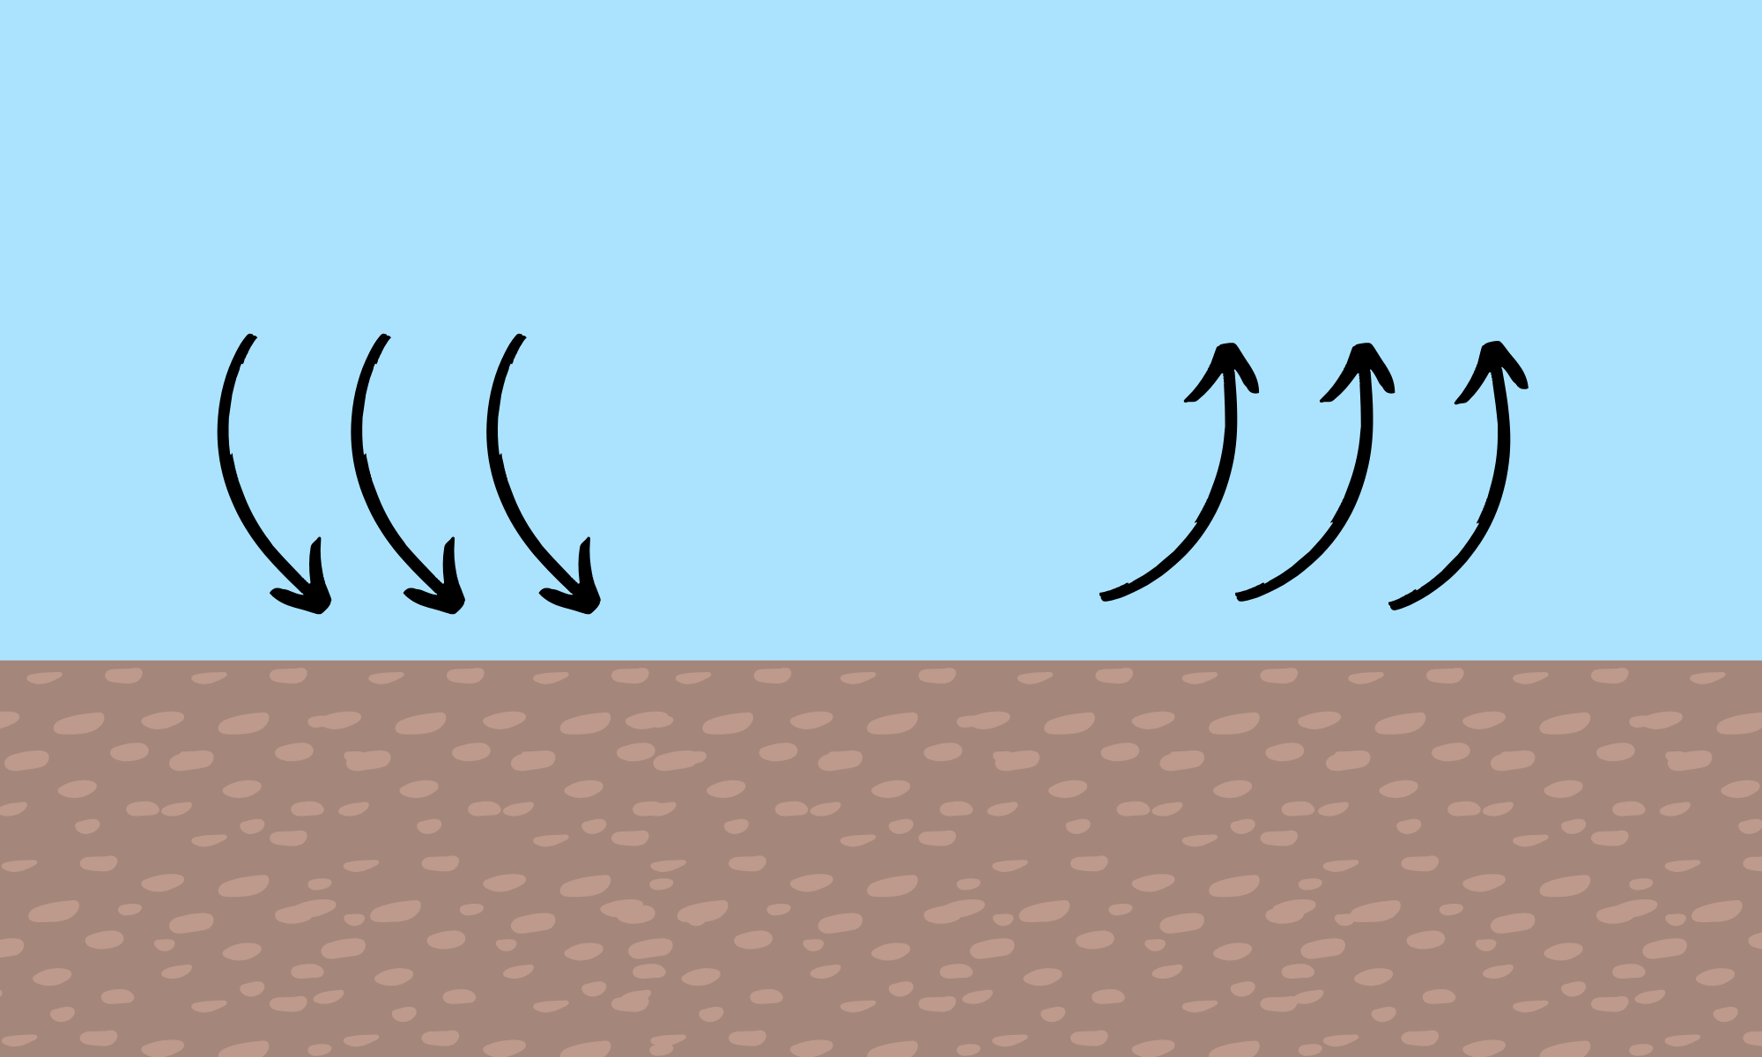
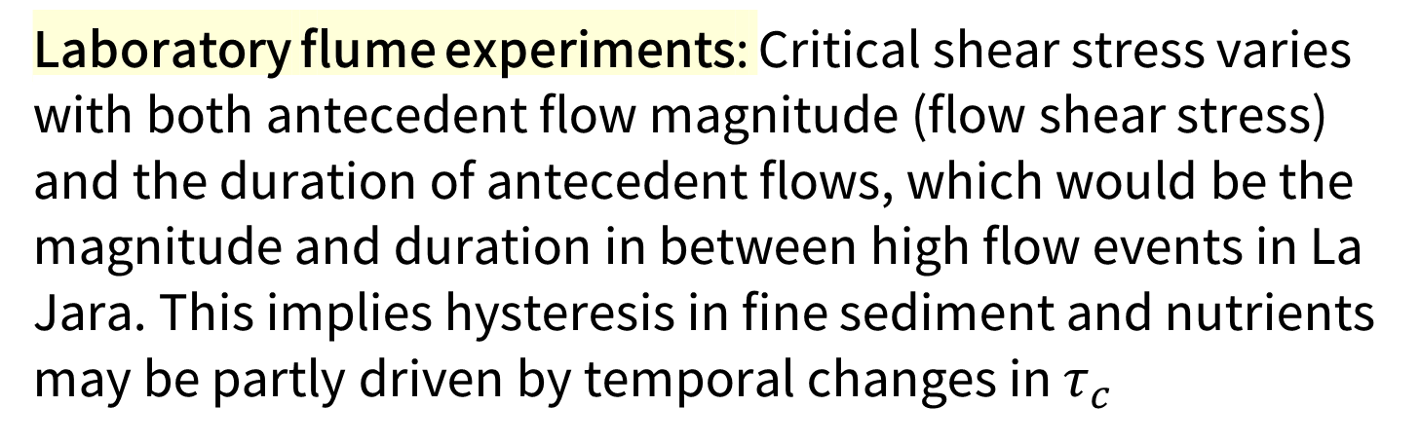
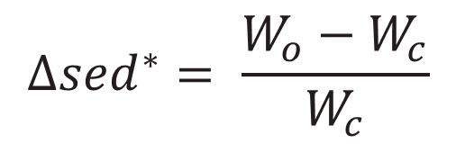
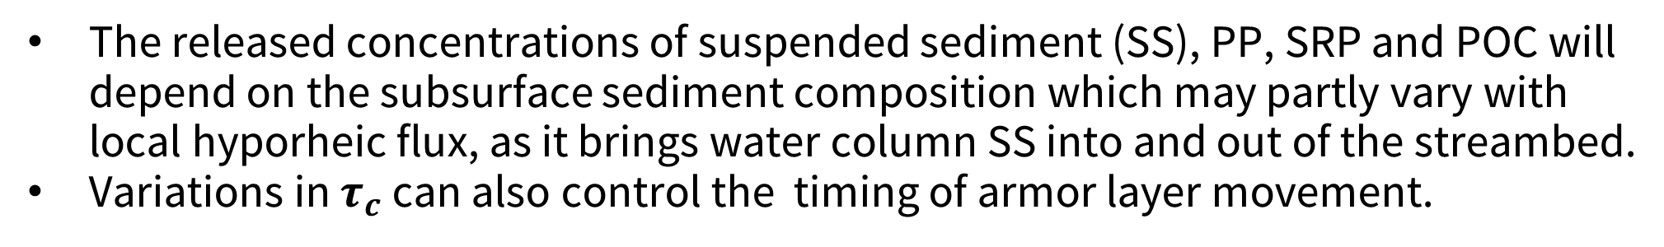

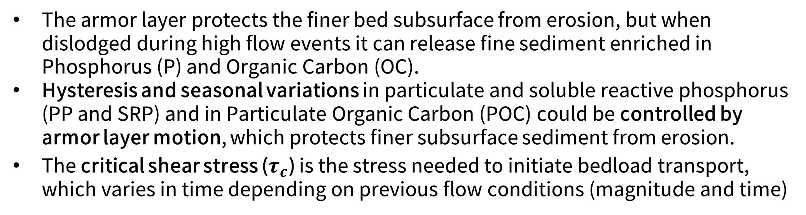
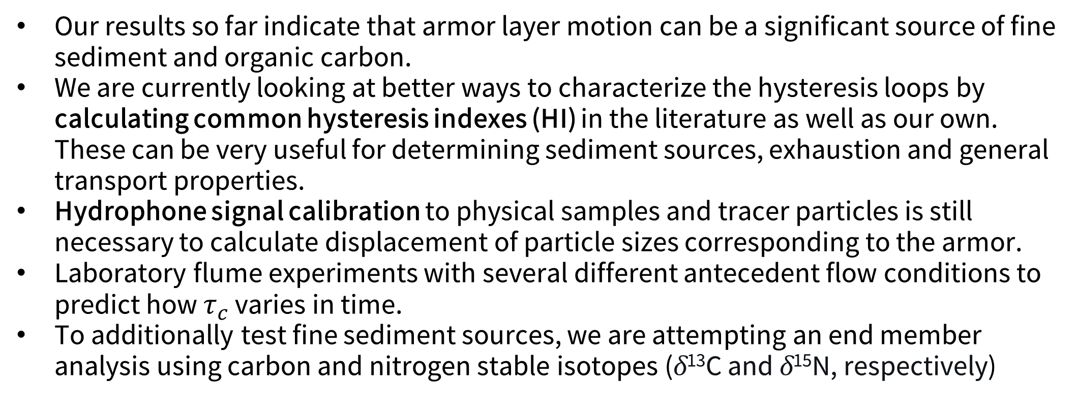

Hyporheic flux and antecedent flow conditions influence the retention and release of fine sediment and nutrients from streambeds
Elowyn Yager¹, Nicole Hucke^{1*}, Andrew Tranmer¹, Janice Brahney², Joel Rowland³, Rachel Watts²,
Sebastian Bernal¹, Abigail Toretsky², George Perkins³ and Rose Harris³
¹University of Idaho, Boise, ID
²Utah State University, Logan, UT
³Los Alamos National Laboratory, Los Alamos, NM
Environmental System Science Program
RFID tracer particles: Armor was displaced for each storm. Average traveled distances for each size class and percentage of bed displacement related to peak shear stresses.
Introduction
Results
Seasonal Constituent Hysteresis
The armor layer protects the finer bed subsurface from erosion, but when dislodged during high flow events it can release fine sediment enriched in Phosphorus (P) and Organic Carbon (OC).
Hysteresis and seasonal variations in particulate and soluble reactive phosphorus (PP and SRP) and in Particulate Organic Carbon (POC) could be controlled by armor layer motion, which protects finer subsurface sediment from erosion.
The critical shear stress ($τ_{c}$) is the stress needed to initiate bedload transport, which varies in time depending on previous flow conditions (magnitude and time)
A total of 7 summer storm and 4 snowmelt high flow events were captured for hysteresis.
Peak constituent concentrations
Storm | SS (uL/L) | POC (mg/L) | SRP (mg/L)
ST1 | 403.52 | 41.28 | 0.090
ST2 | 206.82 | 6.78 | 0.071
ST3 | 204.03 | 5.37 | 0.051
ST4 | 327.45 | 13.91 | 0.072
ST5 | 183.81 | 5.55 | 0.082
ST6 | 232.05 | 12.67 | 0.177
ST7 | 95.96 | 5.137 | -
SM1 | 85.50 | - | -
SM2 | 64.14 | 2.29 | -
SM3 | 87.10 | 3.15 | -
SM4 | 99.54 | 2.92 | -
Example Hysteresis Patterns in Summer and Spring
Q
and
[C]
A
B
C
D
Time
Fine sediment deposition
Low Flow
Large Flow
Q
and
[C]
Peak shear stress and resulting SS hysteresis
Storm | Peak τ (Pa) | SS Hysteresis
ST1 | 74.39 | Clockwise
ST2 | 23.24 | Clockwise
ST3 | 31.55 | Clockwise
ST4 | 19.49 | Clockwise
ST5 | 2.76 | Clockwise
ST6 | 2.27 | Clockwise
ST7 | 6.69 | Clockwise
SM1 | 81.41 | Clockwise
SM2 | 89.63 | Clockwise
SM3 | 126.94 | Clockwise
SM4 | 114.51 | Counter-Clockwise
Time
Fines are protected by armor
Armor begins to move
Fines are released in water
The released concentrations of suspended sediment (SS), PP, SRP and POC will depend on the subsurface sediment composition which may partly vary with local hyporheic flux, as it brings water column SS into and out of the streambed.
Variations in $τ_{c}$ can also control the timing of armor layer movement.
Methods
Spring POC concentrations were too low that no reliable hysteresis could be obtained, and no phosphorus was analyzed for the spring
1. Capturing Hysteresis:
Study Site: La Jara Creek,
Valles Caldera National Preserve, NM
Turbidity
Counter-Clockwise
Clockwise
Collected using a YSI EXO2 Sonde
τ
and
[C]
τ
and
[C]
Water samples (SS, SRP, PP and POC)
Time
Time
Stage-triggered portable ISCO samplers
Particulate constituents (SS, POC and PP) exhibited clockwise hysteresis in the summer. SS behaved similarly in the spring, except for the last high flow event, suggesting depletion of local sediment sources after consecutive high flow events.
Flow depth and Discharge
Pressure transducers in stilling wells
Channel slope: 8-10% and width: 1 m
Dissolved constituents (SRP) differed in their behavior. Hysteresis for SRP changed for different summer storms. This suggests that SRP might come from different source.
2. Armor layer movement:
Laboratory Procedures
Tracer particles and Hydrophones
SS – Laser diffraction
method (LISST portable XR)
POC – Eurovector elemental analyzer coupled to an Isoprime IRMS
SRP & PP – SpectraMax M2e
Constituent concentrations were higher in the summer on average, while also experiencing lower peak shear stresses compared to the spring.
Particle sizes & distances
Particle sizes & timing
Tracer particle locations were recorded before and after each high flow event and transported distances were computed through the triangulation method
Results
Armor Layer Movement and $τ_{c}$
Hydrophone acoustic signals determine when armor layer moves
Laboratory flume experiments to quantify how $τ_{c}$ varies with antecedent flow conditions
RFID tracer particles: Armor was displaced for each storm. Average traveled distances for each size class and percentage of bed displacement related to peak shear stresses.
3. Hyporheic-induced sediment deposition:
Hydrophones: Preliminarily, all summer storms had sediment transport occur on the rising limb of the hydrograph, and specific transported sizes are yet to be determined. Spring recordings have not yet been analyzed.
Sediment traps with open and closed bottoms were installed next to hyporheic flux probes during the spring and summer of 2023
Timing Between Hydrograph Peak and First Sediment Transport Acoustic Signal
Storm | Date | Hydrograph Peak Time | Transport Signal Time
ST1 | 07/23/2021 | 16:30 | 13:01
ST2 | 08/03/2022 | 15:15 | 14:31
ST3 | 08/08/2022 | 15:00 | 14:16
ST4 | 07/29/2023 | 15:30 | 13:30
ST5 | 08/13/2023 | 18:45 | 18:30
ST6 | 08/28/2023 | 12:15 | 12:15
ST7 | 09/14/2023 | 18:00 | 14:00
Hyporheic…
iFLOW (Bertagnoli, et al., 2024) to calculate advective flux using temperature record of the probes
Results
Hyporheic-Driven Fine Sediment Deposition
Laboratory flume experiments: Critical shear stress varies with both antecedent flow magnitude (flow shear stress) and the duration of antecedent flows, which would be the magnitude and duration in between high flow events in La Jara. This implies hysteresis in fine sediment and nutrients may be partly driven by temporal changes in $τ_{c}$
Percent Difference:
Wo > Wc
Total Trapped Sediment .
$$∆{sed}^{∗}= \frac{W_{o}−W_{c}}{W_{c}}$$
- Downwelling:
more sediment in open traps
Wo < Wc
Current and Future Work
StreamLab at the Center for Ecohydraulics Research, Boise
- Neutral fluxes:
similar amounts
Our results so far indicate that armor layer motion can be a significant source of fine sediment and organic carbon.
We are currently looking at better ways to characterize the hysteresis loops by calculating common hysteresis indexes (HI) in the literature as well as our own. These can be very useful for determining sediment sources, exhaustion and general transport properties.
Hydrophone signal calibration to physical samples and tracer particles is still necessary to calculate displacement of particle sizes corresponding to the armor.
Laboratory flume experiments with several different antecedent flow conditions to predict how $τ_{c}$ varies in time.
To additionally test fine sediment sources, we are attempting an end member analysis using carbon and nitrogen stable isotopes (δ¹³C and δ¹⁵N, respectively)
- Upwelling:
more sediment in closed traps
Vertical hyporheic flux can change sediment deposition by ±50%
Downwelling
Upwelling
Longer suspended sediment duration in spring allows for hyporheic flux to influence deposition from the water column for longer, enhancing its effect.
Hyporheic flux may be able to influence deposition of sand moving as bedload.
For questions, please contact huck4481@vandals.uidaho.edu or eyager@uidaho.edu

